Slide 1

ORGANISING FRAMEWORK FOR OCCUPATIONS (OFO)
Compiled by: Ms Phuti Mfoloe
Date : 15 January 2024

Slide 2

PRESENTATION OUTLINE
What is OFO
Purpose of OFO
OFO background
Users of OFO
Definitions
OFO Structure
Skills levels
Alignment of OFO to NQF and Skills level
Process for OFO update
Identified challenges

Slide 3

WHAT IS OFO
The OFO is a skills-based coded classification system that captures all jobs in the form of occupations and provides a framework for the identification, reporting and monitoring of skills demand and supply in the South African labour market.
It provides a common language when talking about jobs in the form of occupations using digital codes; and
groups occupations into successively broader categories and hierarchical levels based on similarity of tasks, skills and knowledge

Slide 4
THE PURPOSE OF OFO
It provide information for the development of Sector Skills Plans by SETAs
Assist with the identification of critical and scarce skills.
Assist employers with identification and development of WSP and ATR.
Assist SETAs to identify skills development needs, sectorial priority occupations and interventions (SPOI) in the labour market.
Assist Post-School Education and Training (PSET) system in developing qualifications that respond to the labour market requirements

Slide 5
THE OFO BACKGROUND
South African Standard Classification of Occupations (SASCO), Australian and New Zealand Standard of Classification of Occupations (ANZSCO) and International Standard Classification of Occupations (ISCO) models were considered in the development of OFO.
In agreement with the SETAs it was decided to use ISCO as the basis for the OFO tool as it captured six digits code.
The structure of the OFO is predetermined by ISCO standard

Slide 6
USERS OF OFO
  SETAs use the OFO codes to develop and report on SPOI list.
  Employers use it to plan and develop their WSPs and ATRs.
  Quality Council for Trades and Occupations (QCTO) use it as a basis for occupational qualification development and certification
  National Artisan Moderation Body (NAMB) for implementation of listed trades.
  PSET system for development of qualifications and planning for the labour market.
  Career Development Services uses the OFO for developing learning Pathways.

Slide 7
DEFINATIONS
A job is a set of tasks and duties carried out by one person for a particular employer, including self-employment, e.g Finance Clerk
An occupation is a set of jobs whose main tasks and duties are characterised by a high degree of similarity, e.g Finance Manager
Specialisation can be regarded as the process of focusing an occupational concentration on a specific area of expertise, e.g Eye Surgeon.
An occupation descriptor indicates the unique service the occupation renders or the unique product the occupation produces in executing some or all the related tasks in a specific context.
Skill is the ability to carry out tasks and duties of a given job

Slide 8
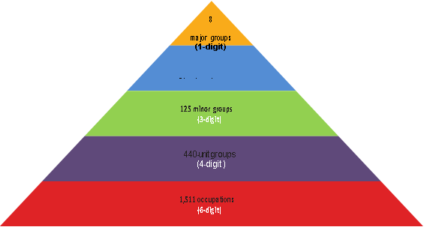
OFO STRUCTURE
39 sub-major groups
(2-digit)

Slide 9
OFO STRUCTURE Cont.…
1. Major Group
1 Digit
The broadest level of the classification
Differ based on skill level and the broadest concept of skill specialisation
2 Professionals
2. Sub Major Group
2 Digits
Sub-divisions of Major Groups
Distinguished based on broadly stated skill specialisation
24 Business and Administration professionals
3. Minor Group
3 Digits
Sub-divisions of Sub Major Groups
Distinguished based on less broadly stated skill specialisation
241 Finance Professionals
4. Unit Group
4 Digits
Sub-divisions of the Minor Groups
Distinguished based on a finer degree of skill specialisation
2411 Accountants
5. Occupations
6 Digits
Relates to a cluster of jobs which involve the performance of a common set of tasks.
241101 General Accountant
6. Specialisations
6 Digits
Skill specialisation is considered in terms of four conceptual concepts:
• the field of knowledge required;
• the tools and machinery used;
• the materials worked on or with; and
• the kinds of goods and services produced.
241101 Bank Accountant
241102 Cost Accountant

Slide 10
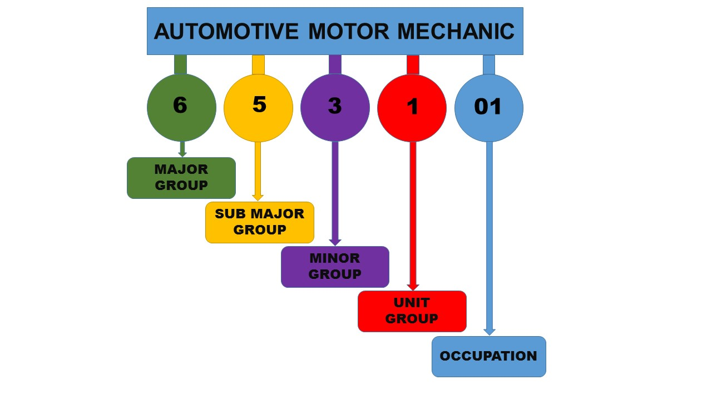
OFO STRUCTURE Cont.…
OFO codes using 2021 version (2021-653101)

Slide 11
SKILLS LEVEL
The Skill levels are defined in terms of formal education and training, previous experience and on-the-job training.
Skill level 1
Occupations at Skill level 1 have a level of skill consisting of one of the following:
NQF Level 1 and 2 qualification;
Compulsory secondary education up to Grade 10; and
For some Occupations a short period of on-the-job training may be required in addition to or instead of the formal qualification. In some instances, no formal qualification or on-the-job training may be required
Skill Level 2
NQF Level 3, 4 and 5 qualification or at least 1 year of relevant experience may substitute for the formal qualification; and
In some instances, relevant experience may be required in addition to the formal qualification.
Skill Level 3
NQF Level 6 qualification
At least 3 years of relevant experience may substitute for the formal qualifications listed above.
In some instances, relevant experience and/or on-the-job-training may be required in addition to the formal qualification.
Skill Level 4
NQF level 7 to 10 qualification; or
At least 3-5 years of relevant experience and/or on-the-job-training may be required in addition to the formal qualification.

Slide 12
ALIGNMENT OF OFO TO NQF AND SKILLS LEVEL

Slide 13
PROCESS FOR OFO UPDATE
Update release is done every second year by DHET
Stakeholders submit OFO request to their respective SETA
SETA’s OFO coordinator submit consolidated OFO request to DHET
DHET evaluate the request and if approved they form part of the OFO structure

Slide 14
PROCESS FOR OFO UPDATE cont…
The OFO inputs template should be completed in line with the OFO standard criteria
A. Name of submitting SETA | B. Action requested by SETA | C. Occupation Code | D. Unit Group Code | E. Name of Occupation to be added/moved/ deleted/amended | F. Descriptor of occupation to be added/ moved/ deleted/ amended | G. Specialization to be added/moved /deleted/amended | H. Alternative Title to be added /moved /deleted /amended | I. Detailed Motivation
SETAs are allowed to submit the following requests to the Department:
Add Occupation/Alternative Title/Specialization/Descriptor of an occupation
Move Occupation/Alternative Title/Specialization/Descriptor
Delete Occupation/Alternative Title/Specialization/Descriptor
Amend Occupation/ Alternative Title/Specialization/ Descriptor

Slide 15
IDENTIFIED CHALLENGES
Poor stakeholder engagement on the OFO by SETAs
Employers do not know how to use OFO structure i.e identifying the correct OFO code
Incomplete/unclear submission of OFO request to DHET
Confusion between the occupations, alternative and specializations
Confusion of job titles or positions with occupations
Difficulty with mapping the job titles to occupations using the OFO
Using wrong OFO version and codes when reporting

Slide 16


Slide 17


